Slide 1
POWER BI PROJECT
FORMULA 1
Race Performance Analytics Dashboard
Data Cleaning, EDA & Power BI Dashboard | Chandigarh College of Engineering
Presented by Krish Sharma | 2405039377
Course B.Tech — Computer Science & Engineering
Date 30 June 2026

Slide 2
00
AGENDA
What We'll Cover
01
Introduction — Problem Statement & Objectives
05
Exploratory Data Analysis — Key Patterns
02
Dataset Overview — Source, Files & Key Fields
06
Power BI Dashboard Walkthrough
03
Merging the Datasets into One Master Table
07
Key Findings & Insights
04
Data Cleaning & Feature Engineering
08
Conclusion & Future Scope
F1 Race Performance Analytics • Power BI Project
2

Slide 3
01
INTRODUCTION
Problem Statement & Objectives
PROJECT OBJECTIVES
THE PROBLEM
Clean and merge six raw F1 datasets into one master table
Engineer features — winner, podium, pole position, positions gained
Run exploratory analysis on driver, constructor & race trends
Design an interactive Power BI dashboard with 8+ visual types
Surface insights on driver dominance, reliability & strategy
F1 fans, analysts, and broadcasters lack a single place to explore 75 years of race history. Driver and constructor stats are scattered across raw CSVs, making it hard to compare eras, track reliability trends, or see how grid position affects results.
TARGET USER
F1 enthusiasts, content creators, and sports analysts who want a fast, visual way to explore historical race data instead of digging through raw spreadsheets.
F1 Race Performance Analytics • Power BI Project
3

Slide 4
02
DATASET OVERVIEW
Source, Structure & Key Fields
Kaggle
6
26,000+
21
SOURCE
CSV FILES
ROWS
COLUMNS
SOURCE FILES MERGED INTO ONE MASTER TABLE
JOIN KEYS
races.csv — Race calendar, year, round, circuit
driverId
constructorId
raceId
circuitId
results.csv — Finishing position, points, status
drivers.csv & constructors.csv — Driver & team names, info
circuits.csv — Track name, location, country
qualifying.csv — Q1 / Q2 / Q3 session times
All six files joined on these shared identifiers to build one analysis-ready table.
F1 Race Performance Analytics • Power BI Project
4

Slide 5
03
DATA INTEGRATION
Merging Six Datasets into One Master Table
races.csv
results.csv
drivers.csv
constructors.csv
circuits.csv
qualifying.csv
master_f1_dataset.csv
One driver-race row • 21 final columns • joined on driverId, constructorId, raceId & circuitId
All six files were joined in Python (pandas) and Power Query on shared identifiers, producing a single wide table that powers both the EDA notebook and the Power BI dashboard.
F1 Race Performance Analytics • Power BI Project
5

Slide 6
04
DATA CLEANING
Data Cleaning & Feature Engineering
0
68
7
21
DUPLICATE ROWS
VALID NULLS (QUALIFYING)
ENGINEERED FEATURES
FINAL MASTER COLUMNS
NEW FEATURES ENGINEERED
DATA QUALITY OBSERVATIONS
winner — Flags the race winner (P1 finish)
No duplicates or missing values in races, results, drivers, constructors, or circuits
Qualifying nulls in Q2/Q3 kept — they mark drivers eliminated early
fastestLapSpeed nulls retained — unavailable for older/retired entries
Date column converted to datetime for time-based trend analysis
podium — Flags top-three finishes
pole_position — Flags drivers who started P1
positions_gained — Grid position minus finishing position
F1 Race Performance Analytics • Power BI Project
6

Slide 7
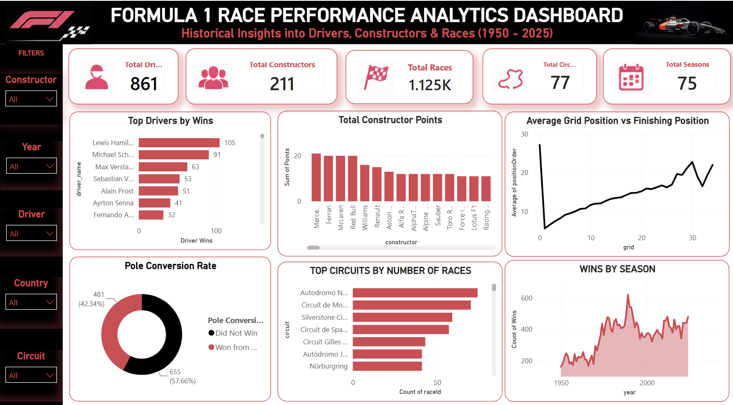
05
POWER BI DASHBOARD
F1 Race Performance Analytics Dashboard
F1 Race Performance Analytics • Power BI Project
7

Slide 8
06
KEY VISUALS
Top Drivers by Wins
105
CAREER WINS — LEWIS HAMILTON
Lewis Hamilton leads all-time wins, ahead of Michael Schumacher (91) and Max Verstappen (63) — sustained dominance across multiple eras of the sport.
Source: master_f1_dataset.csv — results grouped by driver, filtered to race wins.
F1 Race Performance Analytics • Power BI Project
8

Slide 9
06
KEY VISUALS
Qualifying Pace vs. Race Outcome
POLE POSITION CONVERSION RATE
42.3%
of pole positions convert into race wins
Starting from pole improves the chances of winning, but does not guarantee success — race strategy, tyre management, and reliability still play crucial roles.
GRID vs. FINISH POSITION
Average finishing position rises steadily as starting grid position worsens — qualifying performance still strongly shapes the final result, though overtakes and reliability add variance.
F1 Race Performance Analytics • Power BI Project
9

Slide 10
06
KEY VISUALS
Races Across History — Circuits & Seasons
TOP CIRCUITS BY NUMBER OF RACES
WINS BY SEASON • 1950 – 2025
75
1.125K
SEASONS OF RACING
TOTAL RACES
Wins per season climbed sharply through the 1980s–2000s as the calendar expanded, then plateaued at a high, steady rate in the modern era.
Monza, Monaco, and Silverstone — three of F1's oldest venues — host the most Grands Prix of all 77 circuits, anchoring the calendar across 75 seasons.
F1 Race Performance Analytics • Power BI Project
10

Slide 11
07
KEY FINDINGS
Key Findings & Insights
1
Lewis Hamilton leads all-time wins with 105, ahead of Michael Schumacher (91) and Max Verstappen (63) — sustained dominance across eras.
2
Ferrari, Mercedes, and McLaren top constructor points, but win-percentage analysis shows efficiency favors different teams than raw win counts.
3
Pole position converts to a win only 42.3% of the time — strategy, tyres, and reliability matter as much as raw qualifying pace.
4
Average finishing position rises steadily with starting grid position, confirming qualifying performance still strongly shapes race outcomes.
5
Monza, Monaco, and Silverstone host the most Grands Prix of all 77 circuits — historic venues anchor the F1 calendar across 75 seasons.
F1 Race Performance Analytics • Power BI Project
11

Slide 12
08
CONCLUSION
Conclusion & Thank You
Built an end-to-end pipeline — six raw F1 CSVs to a cleaned master dataset, Python EDA, and a published Power BI dashboard
Most important finding: pole position wins only 42% of the time, proving race strategy and reliability outweigh raw qualifying pace
Technique: engineering winner, podium, and positions-gained flags directly from raw grid & finishing data with Pandas
Future scope: add lap-by-lap telemetry, weather data, and predictive models for race outcomes
Questions & Feedback Welcome
Krish Sharma | 2405039377

